Slide 1


Network Security Situation Awareness Based on Spatio-temporal Correlation of Alarms
Zehua Ren¹, Yang Liu^{1*}, Huixiang Liu¹, Baoxiang Jiang¹, Xiangzhen Yao², Lin Li², Haiwen Yang³ and Ting Liu¹
1 MoE KLINNS, Xi’an Jiaotong University, Xi’an, Shaanxi, China
2 Cyber Security Research Center , China Electronics Standardization Institute, Beijing, China
3 State Grid Shaanxi Electric Power Company Limited, Xi’an, Shaanxi, China
∗ Corresponding author. Email: yangliu@xjtu.edu.cn.
IEEE INFOCOM 2022,
May 2-5, 2022, Virtual Conference

Slide 2


1
Introduction
Background
Research Motivation
2
System Architecture
3
Demo System
4
Conclusion and Future Work

Slide 3
Introduction
1.1
Background
False Alarms in Intrusion Detection Systems (IDSs)
I don't want to design filtering rules manually.
How about the current network security situation?
How to automatically generate filter rules?
Massive alarm events
Network devices

Slide 4
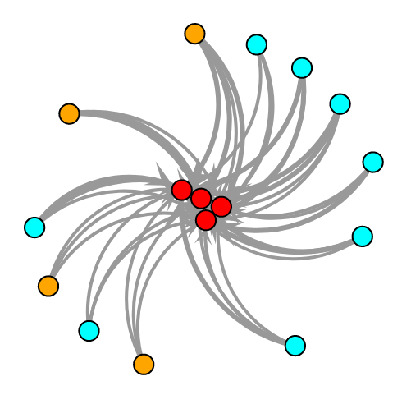
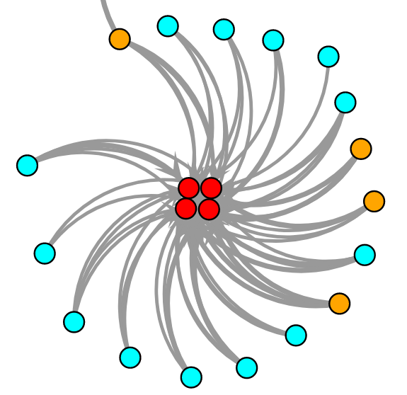
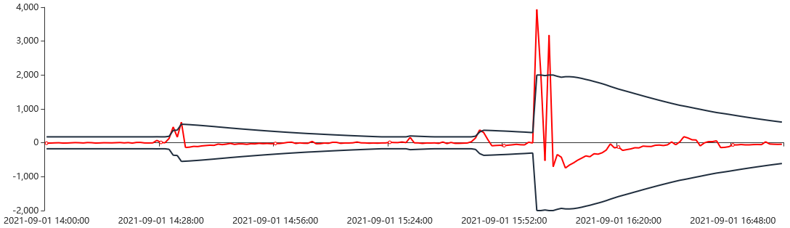
Introduction
1.2
Research Motivation
The spatio-temporal correlation of alarms.
Application scenarios:
- Business intranet
- Industrial control network
2021-09-03 00:00:00
2021-09-16 18:00:00
Malicious attack
● External device ● Internal user ● Partner company
Alarm type: MISC Attack Event type: Online conference
Changes in statistical indicators over time reflect the occurrence of abnormal events.
Different alarm graphs have same spatial structures: the same generate reasons.

Slide 5
1
Introduction
2
System Architecture
Data Preprocessing
Pattern Mining
Similarity Analysis
3
Demo System
4
Conclusion and Future Work

Slide 6
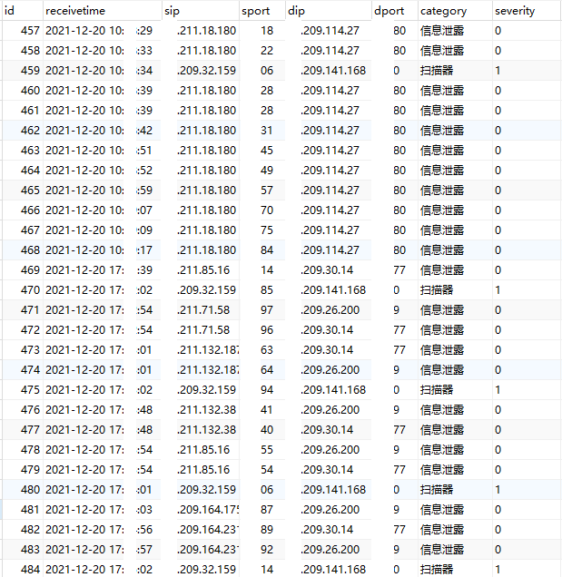
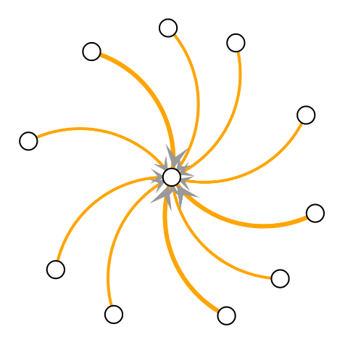
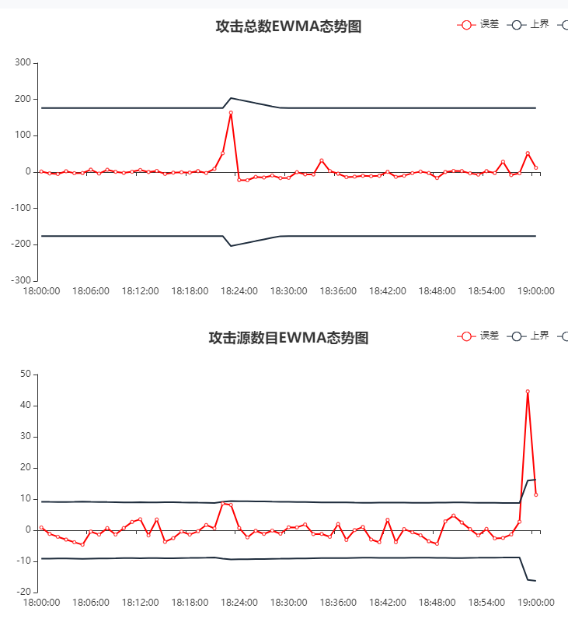
System Architecture
2.1
Data Preprocessing
Original alarms data
Alarm graph
Node: IP address
Time
window
Edge: alarm event
EWMA control chart
Temporal
Correlation
Using Exponential Weighted Moving Average method to find abnormal behaviors.
Dynamically set time window according to the current security situation.

Slide 7
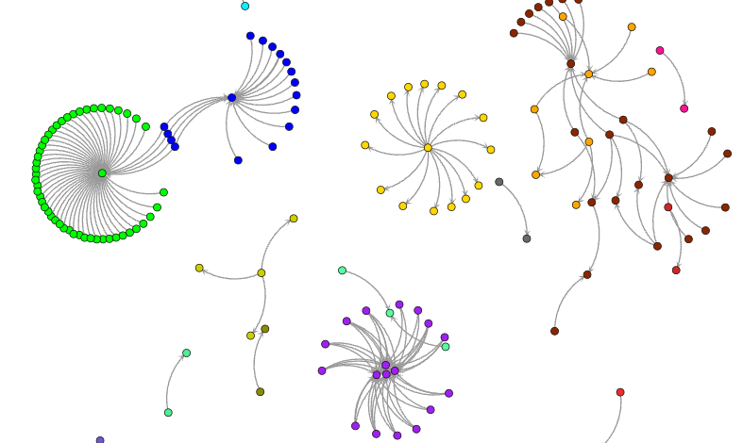
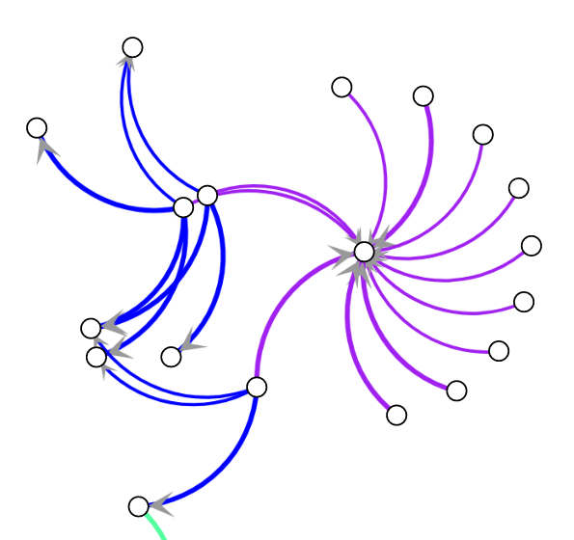
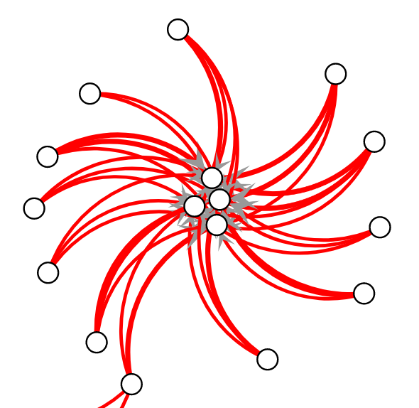
System Architecture
2.2
Pattern Mining
Find alarm groups by community discovery algorithm.
Classify alarm clusters according to topology characteristics.
Single-center Topology
Complex Topology
Spatial
Correlation
Multi-center Topology

Slide 8
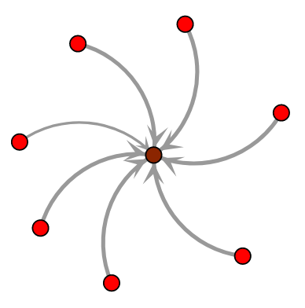
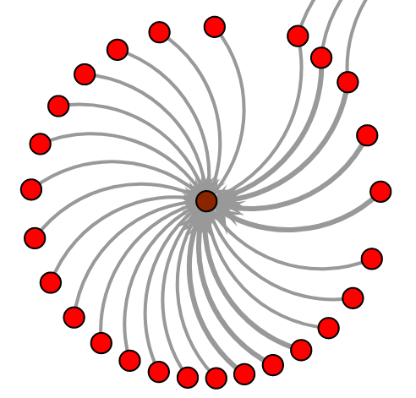


System Architecture
2.3
Similarity Analysis
Event Model: Online conference
Event Model: Conventional attack
2021-09-03 00:00:00
2021-09-16 18:00:00
2021-09-04 14:00:00
2021-10-02 10:00:00
● External device ● Internal user ● Partner company
Type: MISC Attack 100% Type: MISC Attack 100%
Center: External device Center: External device
Around: Part-comp 33% Around: Part-comp 25%
Subgraph motifs: Subgraph motifs:
● External device ● Critical server
Type: Info leakage 100% Type: Info leakage 99%
Center: Critical server Center: Critical server
Around: External 100% Around: External 100%
Subgraph motifs: Subgraph motifs:
6.10%
91.35%
5.88%
94.12%
0%
100%
0%
100%

Slide 9
1
Introduction
2
System Architecture
3
Demo System
System Overview
Core Function
Examples
4
Conclusion and Future Work

Slide 10
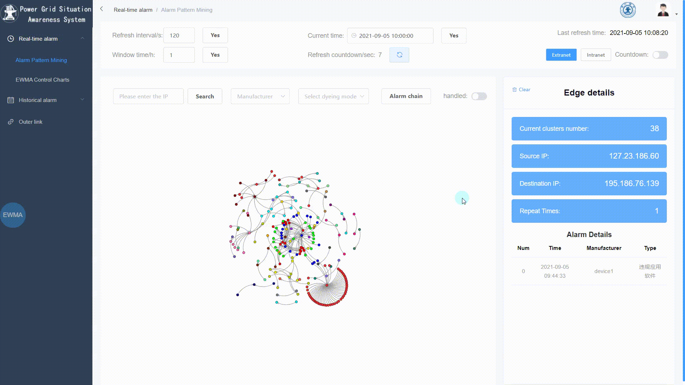
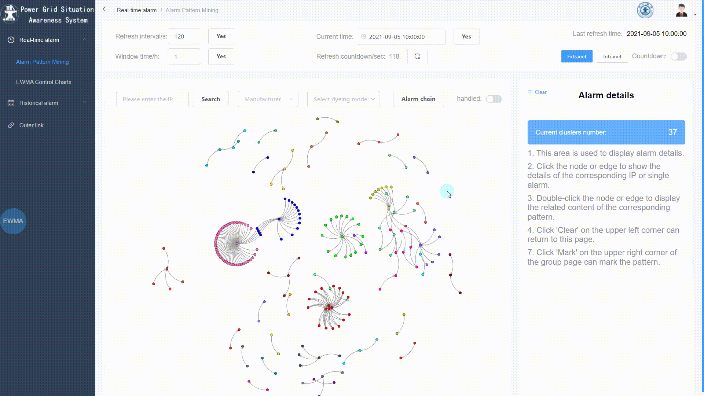
Demo System
3.1
System Overview
Alarm graph visualization.
Check alarm details.
Security risk assessment.
Alarm handling.
Demo video at https://bit.ly/NSSA-ST

Slide 11
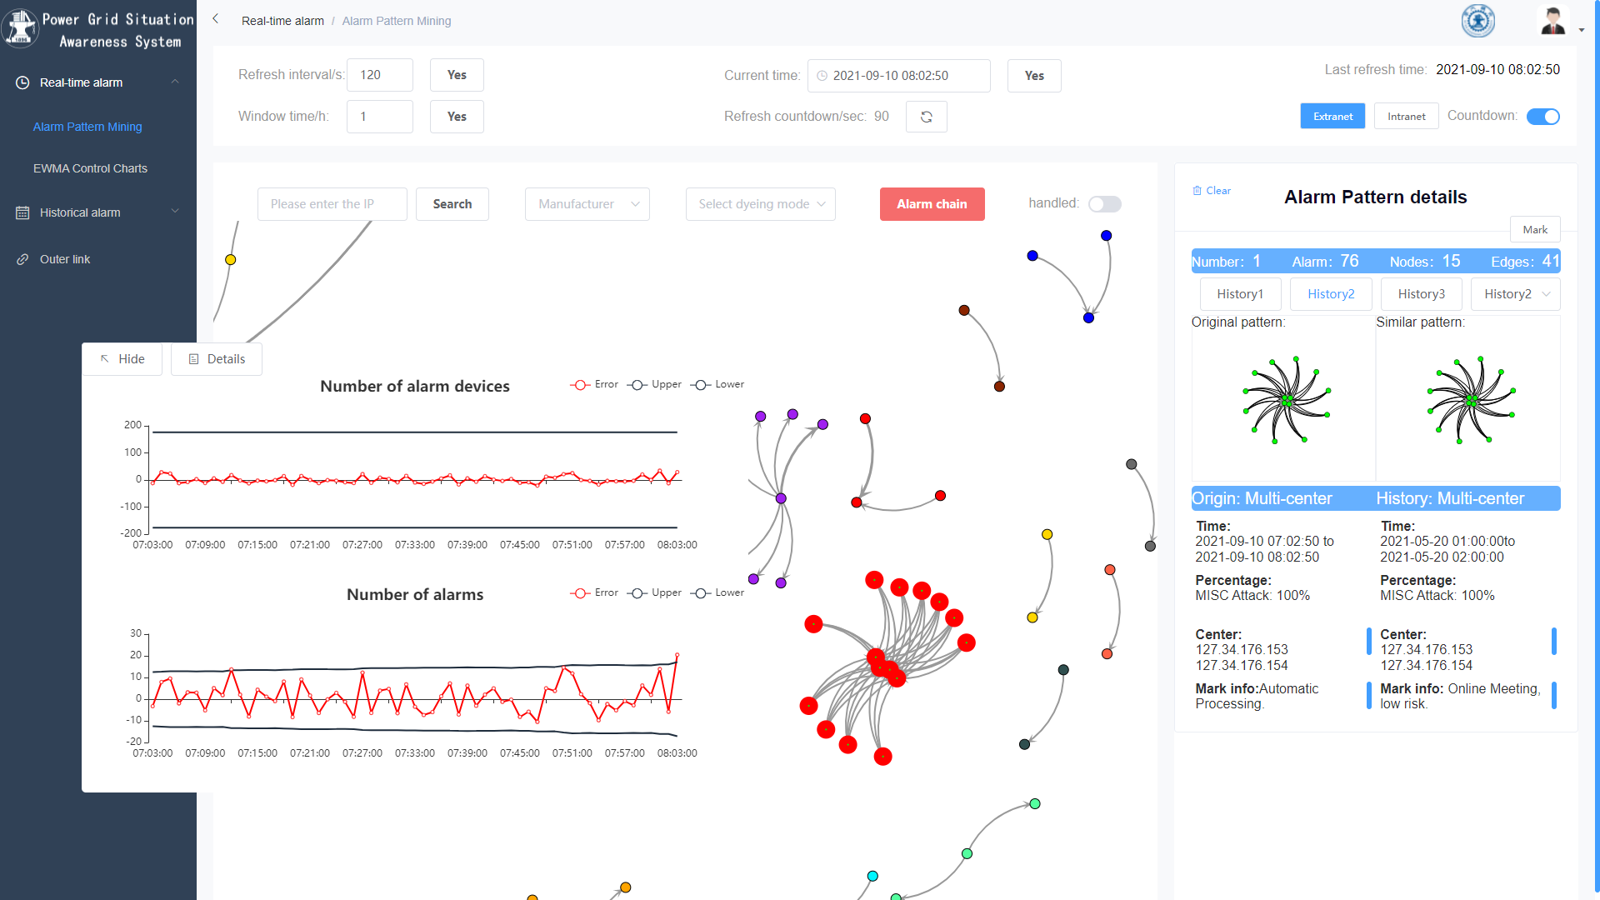
Demo System
3.2
Core Function
3. Matching similar events
1. Detecting abnormal events
2. Locating event on graphs
Demo video at https://bit.ly/NSSA-ST

Slide 12
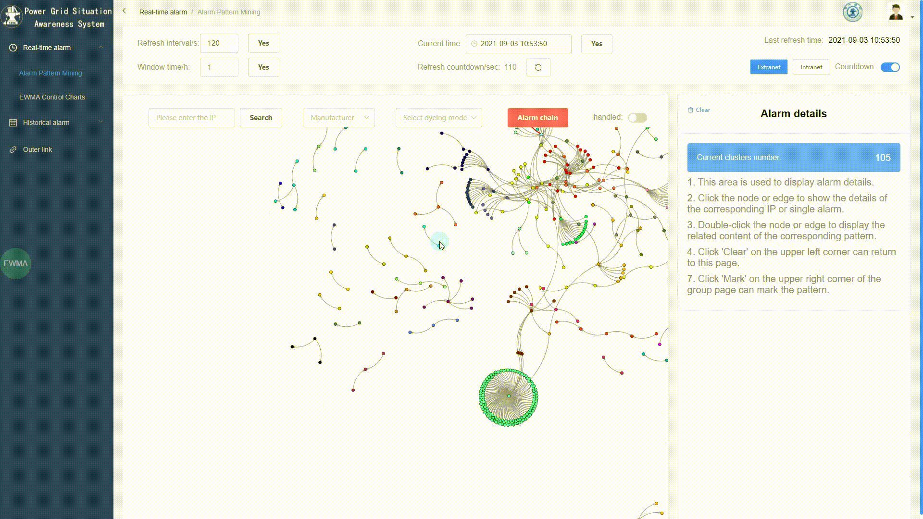
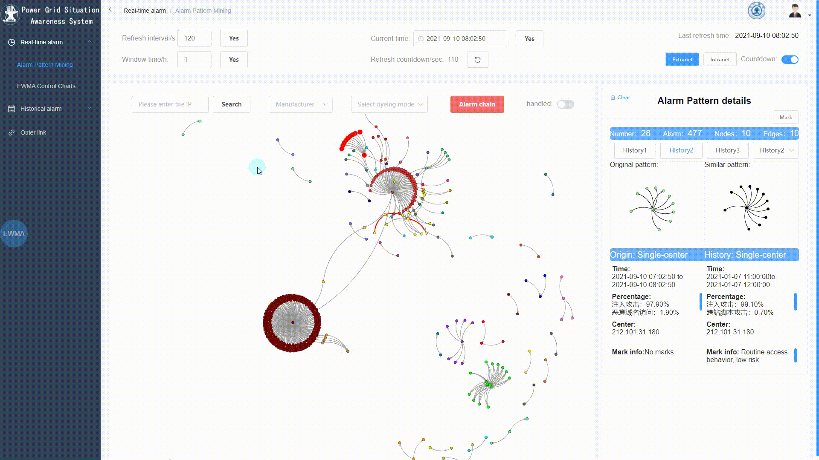
Demo System
3.3
Examples
Semi-automatically detect
high risk patterns.
Automatically deal low-risk alarms.
Demo video at https://bit.ly/NSSA-ST

Slide 13
1
Introduction
2
System Architecture
3
Demo System
4
Conclusion and Future Work
Conclusion
Future Work

Slide 14
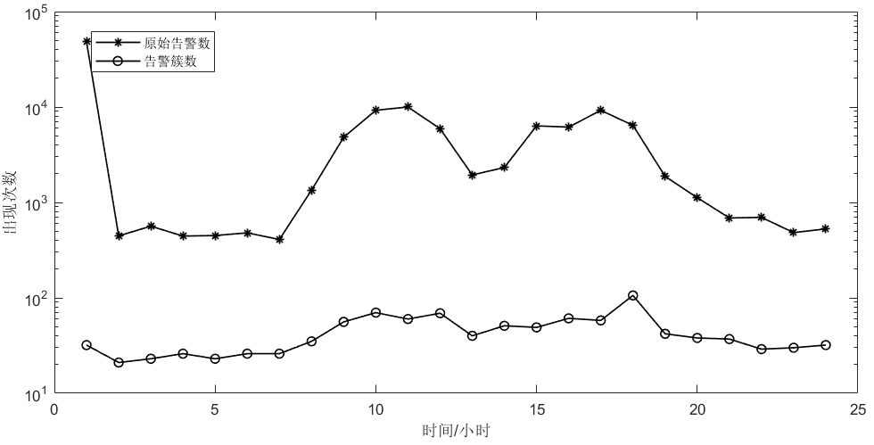
Conclusion and Future Work
4.1
Conclusion
We developed a network security situation awareness (NSSA) system based on the spatio-temporal correlation of alarms.
Our system can detect high risk patterns semi-automatically and deal low-risk alarms automatically based on historical operations.
Compared with the old system, our system has better performance and richer functions.
Original
New
Performance | Original system | Our system
Processing time | More than 10″ | Less than 1″
Data scale | 10³-10⁵ | 10¹-10²
Accuracy | 70% | 95%
Cross-platform | no | yes
Similar matching | no | yes
number
Time/hour

Slide 15
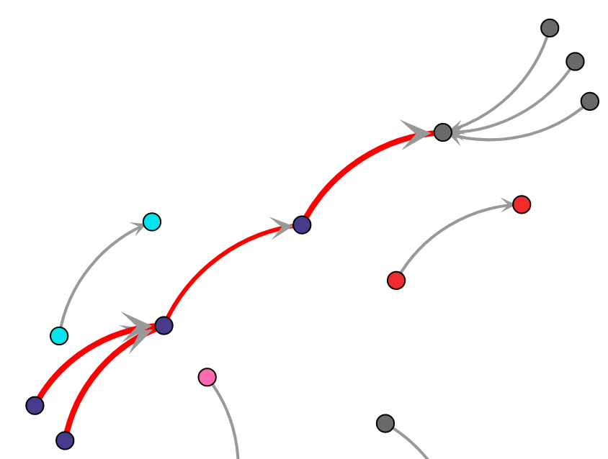
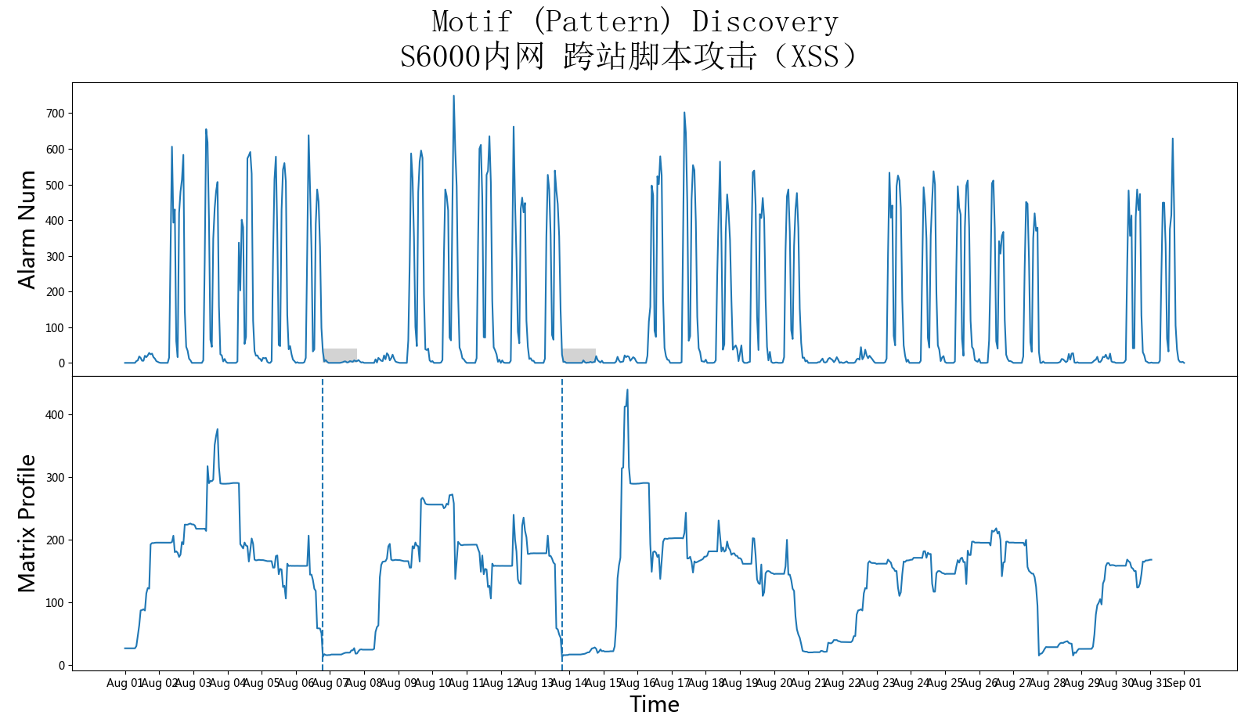
Conclusion and Future Work
4.2
Future Work
The rich visualization of alarm data could also help find hidden high-risk attack behaviors like attack chains.
Consider the temporal periodicity of threat behavior.
2021-08-01~31
Cross Site Scripting
2
3
6
9
1
5
4
7
8
Build hypergraph to better classify different alarms.

Slide 16
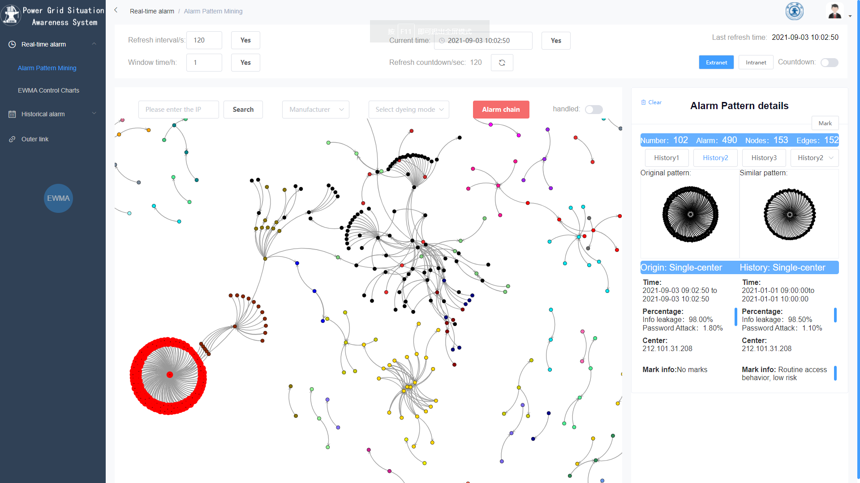
Thank you!
Q&A
Zehua Ren
Xian Jiaotong University
renzehua@stu.xjtu.edu.cn
2022/05/03

